Slide 1
Sharing the Road with Commercial Motor Vehicles
A Web-Based Approach

Slide 2
Introduction
Problem Scope
Over three-quarters of crashes and near-crashes involving heavy-vehicles are primarily caused by light-vehicles.
May be indicative of inadequacies in driver education training programs
Objectives
Develop a website (CMVRoadSharing.org) dedicated to providing video examples of real-world scenarios involving light-vehicle/heavy-vehicle interactions, as well as proper sharing-the-road driving behavior

Slide 3
Key Scenarios
Five key sharing-the-road scenarios:
Don’t Hang Out in the No-Zone
Don’t Cut Trucks Off
Maintain a Safe Following Distance
Properly Passing a Truck
Don’t Get Squeezed!
Website combines naturalistic driving video clips, simulator screenshots, scenario descriptions, short tips and facts, and crash photos.
Notes:
TET note – I added hyperlinks. If you don’t think they are beneficial here, we can remove.

Slide 4
Don’t Hang Out in the No-Zone
Size and height of a truck create four main blind spots around the truck that other drivers should avoid.
These “no-zones” are located at the:
Front of the truck
Back of the truck
Left side of the truck (i.e., driver’s side)
Right side of the truck (i.e., passenger side)
When your vehicle is in a no-zone, it essentially disappears from the truck driver’s view.

Slide 5
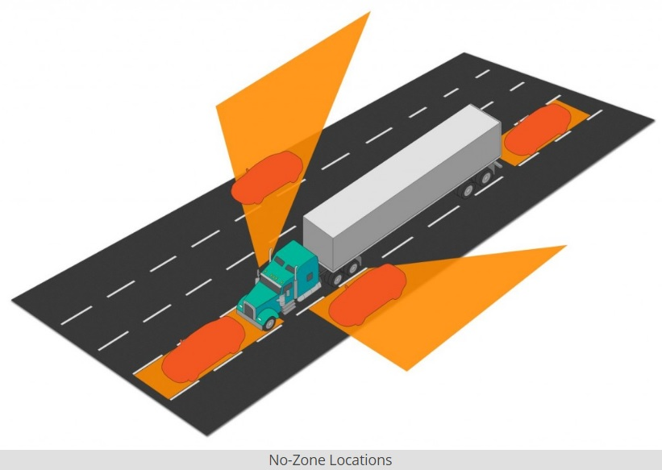
Rule of Thumb #1
The larger the vehicle, the larger the blind spot. If you can’t see the truck driver in his/her mirrors, then the truck driver can’t see you!

Slide 6
No Passing in the Right No-Zone
The right blind spot, or no-zone, is located on the passenger side of the truck and is a huge area where the truck driver can’t see you at all.
This area can be three lanes wide and as long as the trailer.
DO NOT pass on the right of a truck!
It’s the most dangerous area for passing, as you are essentially invisible to the truck driver the entire time you are in the no-zone.

Slide 7
Example of Improper Road Sharing: Passing on the Right
Notes:
Video available at: http://www.cmvroadsharing.org/?page_id=6

Slide 8
Pass Steadily Through the Left No-Zone
The left blind spot, or no-zone, is located on the driver’s side of the truck.
It is nowhere near as dangerous as the right no-zone, but it’s equally dangerous to linger in.
Traveling alongside a truck puts you in danger of being sideswiped if the truck changes lanes or has to swerve for any reason.
If you need to pass a truck, move through the left no-zone steadily until you’re safely past.

Slide 9
Example of Improper Road Sharing: Lingering in the Left No-Zone
Notes:
Video available at http://www.cmvroadsharing.org/?page_id=6

Slide 10
Don’t Cut Trucks Off
Avoid the front no-zone for two reasons:
Due to the size and height of the truck, your vehicle can completely disappear from the truck driver’s view when you enter the front no-zone.
Trucks need plenty of room to brake or slow down. If you’re in the front no-zone and traffic slows down quickly, the truck won’t have enough time to stop.
Unexpected and unpredictable things happen all the time on the road. If you are in the front no-zone and a truck doesn’t have enough time to stop, approximately 80,000 pounds of truck will slam into the back of your car.

Slide 11
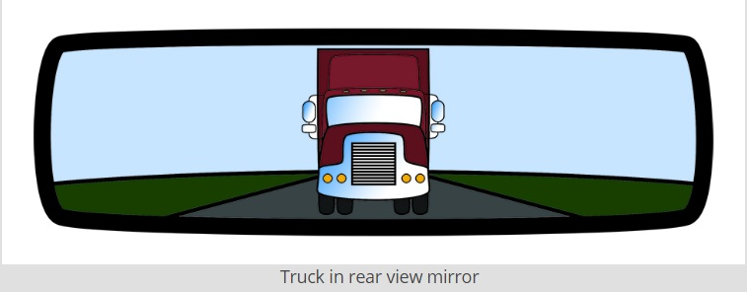
Rule of Thumb #2
Look for the entire front of the truck cab – from the bumper to the top of the cab – in your rearview mirror before changing lanes in front of a truck.

Slide 12
Changing Lanes in Front of a Truck
Under no circumstances should you EVER cut in front of a truck, especially if traffic is slowing or stopped ahead.
Trucks require much longer stopping distances than passenger vehicles:
At 55 mph, it can take a truck more than the length of a football field to stop.
In 2013, 4 out of every 5 people killed in a crash with a truck were occupants of other vehicles.
Don’t risk your life and the lives of your passengers by being impatient.

Slide 13
Example of Improper Road Sharing: Lane Change in Front of a Truck
Notes:
Video available at: http://www.cmvroadsharing.org/?page_id=36

Slide 14
Merging in Front of a Truck
Much like cutting trucks off, merging is dangerous because of the longer stopping distances required for trucks.
A fully loaded truck weighs up to 20 times more than a car so be patient and wait for a truck to pass before merging or changing lanes.
Remember, due to their sheer size and weight, trucks don’t operate the same way that regular vehicles do.
Avoid driving erratically around trucks and give them plenty of time and space to maneuver safely.

Slide 15
Example of Improper Road Sharing: Merging in Front of a Truck
Notes:
Video available at: http://www.cmvroadsharing.org/?page_id=36

Slide 16
Maintain a Safe Following Distance
The rear blind spot, or no-zone, is located behind the trailer of the truck and results from the truck having only side rearview mirrors.
The rear no-zone extends nearly 200 feet from the back of the truck, which is roughly the length of half a football field.
Following too closely can result in an “underride” crash, where the front end of the car is pushed under the rear of the truck’s trailer.
This is not a scenario you want to find yourself in so STAY BACK!
Notes:
Additional information available at: http://www.cmvroadsharing.org/?page_id=39

Slide 17
Following Too Closely
Following too closely is dangerous for a number of reasons:
You have no idea what’s in front of the truck on the road ahead, such as debris, so you won’t have time to safely avoid hitting it.
Truck cargo may move and fall from the truck onto the road. If you’re following too closely, you’ll have no room to avoid colliding with anything that falls in front of you.
You have no view of the traffic flow ahead. If the truck driver has to brake suddenly, you won’t have enough time or space to avoid crashing into the back of the truck, which will result in an underride crash.

Slide 18
Rule of Thumb #3
Look for the truck driver’s mirrors as you are following. Ideally you want to be far enough back to see the mirrors on both sides of the truck. But, at a minimum, you should see the mirror on the left driver’s side.

Slide 19
Properly Passing a Truck
When sharing the road with trucks, it is extremely important to practice proper passing behavior.
Proper passing includes:
NEVER pass on the right.
Do not linger next to the truck, especially in the truck driver’s blind spot. Move at a safe steady speed past the truck.
DO NOT change lanes in front of a truck until you can see the entire front of the truck in your rearview mirror.
NEVER change lanes in front of a truck then brake or slow down suddenly.

Slide 20
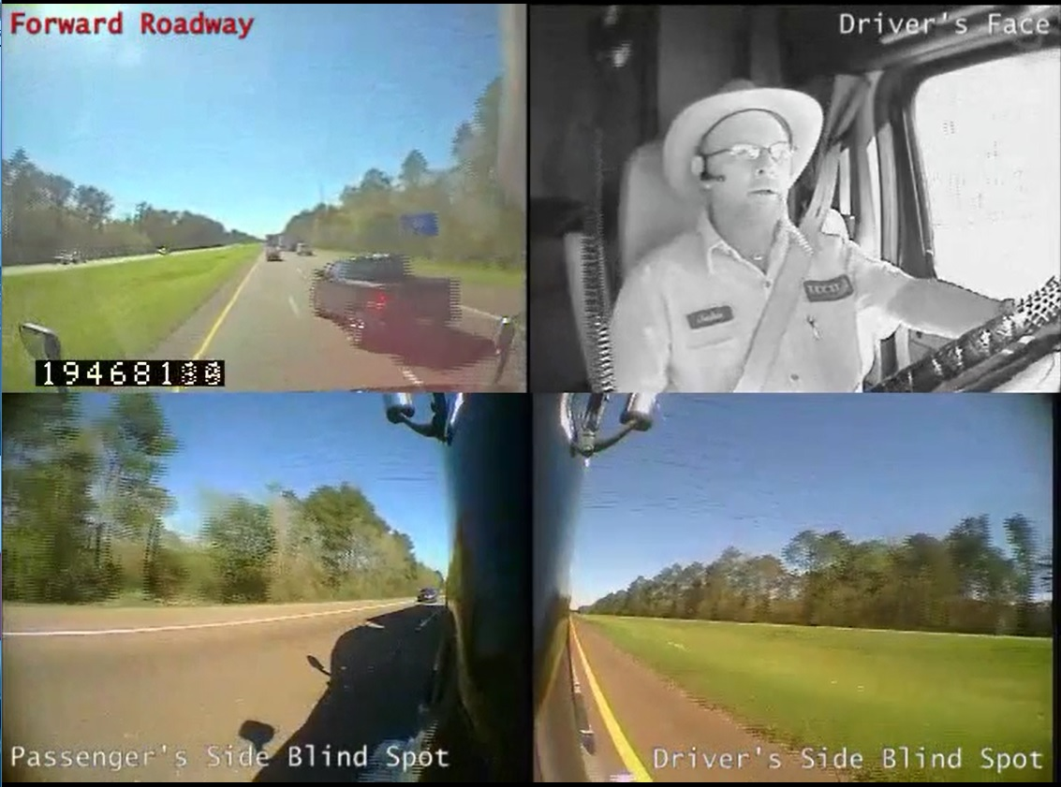
Example of Improper Road Sharing: Passing a Truck
Notes:
Video available at: http://www.cmvroadsharing.org/?page_id=46

Slide 21
Don’t Get Squeezed!
When preparing to turn right at an intersection, a truck driver first needs to swing wide to the left, away from the curb to get the trailer around the corner safely.
It may be tempting to squeeze past on the right between the truck and the curb.
But you should NEVER put yourself in this situation or you could get crushed by the trailer.

Slide 22
Rule of Thumb #4
Avoid passing trucks while they are turning and never attempt to cut in along the right side of a turning truck. Wait to assess the truck driver’s intent before passing.

Slide 23
Improper and Proper Road Sharing Behavior: Don’t Get Squeezed!

Slide 24
Example of Improper Road Sharing: Don’t Get Squeezed!
Notes:
Video available at: http://www.cmvroadsharing.org/?page_id=49

Slide 25
Conclusions
Visit the website:
www.cmvroadsharing.org
By practicing proper and safe road sharing behavior, you can make truck drivers’ jobs easier and safer and reduce the likelihood of finding yourself in a dangerous and potentially life-threatening conflict involving a large truck.

Slide 26
Crash Photos
Notes:
Additional images and information available at: http://www.cmvroadsharing.org/?page_id=54

Slide 27
Final Thoughts…
Remember, one simple mistake, one bad decision, one moment of impatience or recklessness, or one second of poor judgment is all it takes for crashes to occur. Be patient and use good judgment when sharing the road with trucks. It could save your life and the lives of your passengers!

