Slide 1
Driving Healthy
Wellness Over the Road

Slide 2
Driving Healthy: Wellness Over the Road

Slide 3
Learning Objectives
Learners should have an understanding of:
Health concerns among CMV drivers and how health impacts safety
How weight loss can improve overall health
Strategies to help CMV drivers develop positive health behaviors considering their mobile lifestyle
How carriers may develop and implement a successful health and wellness program for their drivers
3

Slide 4
Topics
The Importance of Health and Wellness
Truck Driving: A Risky Occupation
Health Concerns among CMV Drivers
The Connection between Health and Safety for Commercial motor Vehicle (CMV) Operations
Disqualifying Medical Conditions
Health Improvement through Behavior and Lifestyle Modifications

Slide 5
Health and Wellness: Why Is It Important?
Increased energy
Improved quality of life
Alertness and job performance
Longevity on the job
Increased life expectancy

Slide 6
Components of Wellness

Slide 7
Truck Driving: A Risky Occupation
Trucking classified as one of the highest-risk occupations (BLS, 2007).
Workplace conditions encourage unhealthy behaviors.
Shift work/long hours
Chronic physical and psychological stress
Sedentary lifestyle
Poor nutrition/eating habits
Drivers may have a 12-19 year reduced life expectancy (Salzman, 2007).

Slide 8
Health Concerns in CMV Operations

Slide 9
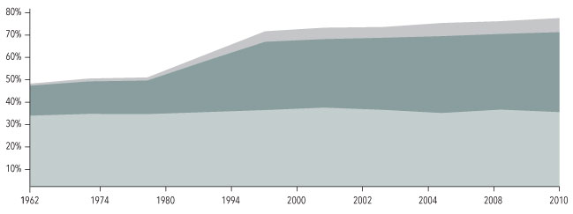
Overweight and Obesity
90% of CMV drivers may be overweight and 70% obese.
Versus 69% and 36% among general U.S. population (NIH, 2017)
Consequences of excess weight:
Heart disease
High blood pressure
High cholesterol
Diabetes
Osteoarthritis
Sleep apnea
Cancer
Depression
■ Overweight ■ Obesity ■ Extreme obesity
Trends in Overweight and Obesity among Adults, United States, 1962 - 2010

Slide 10
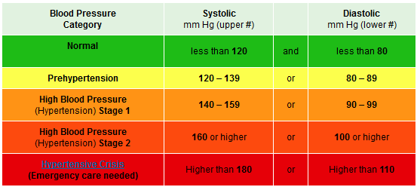
High Blood Pressure (Hypertension)
High BP may affect up to 40% of CMV drivers (Mabry, 2013).
Easily controlled
Lifestyle modifications
BP medications
Risky if uncontrolled
Vascular damage
Heart disease/damage
Neural damage
Notes:
49 CFR 391.43(f) Blood Pressure (BP)
An individual diagnosed with Stage 1 hypertension (BP is 140/90–159/99) may be certified for one year. At recertification, an individual with a BP equal to or less than 140/90 may be certified for one year; however, if his or her BP is greater than 140/90 but less than 160/100, a one-time certificate for 3 months can be issued. An individual diagnosed with Stage 2 (BP is 160/100-179/109) should be treated and a one-time certificate for 3-month certification can be issued. Once the driver has reduced his or her BP to equal to or less than 140/90, he or she may be recertified annually thereafter. An individual diagnosed with Stage 3 hypertension (BP equal to or greater than 180/110) should not be certified until his or her BP is reduced to 140/90 or less, and may be recertified every 6 months."

Slide 11
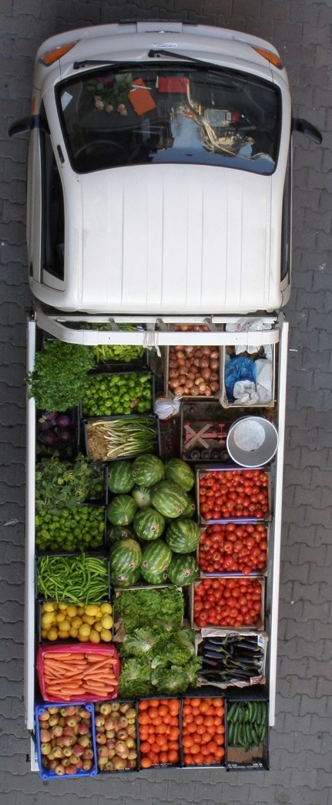
Cardiovascular Disease (CVD)
Professional drivers at increased risk for:
Stroke
Heart attack
Vascular diseases
Heart disease is one of the most serious illnesses affecting truck drivers
Heart attack or acute cardiovascular event during driving could be catastrophic.

Slide 12
Physical Inactivity
Physical activity recommendations
150 mins/week moderate intensity aerobic activity
≥ 2 days/week muscle-strengthening activities
92% of truck drivers are inactive or don’t exercise regularly (Bigert, 2003).
Compared to 28% of the general U.S. population
Exacerbates obesity and related health issues
Directly related to cardiovascular mortality

Slide 13
Nutrition and Eating Habits
Truck-stop and fast food fare
Convenient, low-cost, and “appealing”
Irregular eating schedules
Limited space and opportunity to store and prepare meals on the road
Half of truck drivers report consuming ≤ 1 serving of fruit and vegetables daily (Whitfield, 2007)
But indicate they would choose healthful foods if available and appetizing (Whitfield, 2007)
Notes:
5 servings of fruit and vegetables recommended daily

Slide 14
Type II Diabetes
Prevalence of diabetes among CMV drivers outpaces U.S. population.
12-16% vs. 8% (Mabry, 2013, submitted for publication; ADA, 2011)
Easily controlled
Lifestyle modifications (prediabetes)
Medications
Risky if uncontrolled
Neuropathy
Impaired vision/blindness
Heart disease/stroke
Kidney failure
 | Fasting Glucose (mg/dL)
Normal | < 100
Prediabetes | 100-125
Diabetes | > 125

Slide 15
Short/Poor Quality Sleep
Fragmented and erratic work schedules
Short sleep
Poor quality sleep
Wake-time fatigue
Truckers average 3.8 to 5.2 hrs of sleep daily. (Balkin et al., 2000; Dinges et al., 2005)
6-8 hrs recommended
Sleepiness has been linked with fatal crashes. (Hakkanen et al., 2000; Lyznicki et al., 1998)

Slide 16
Sleep Disorders
Sleep disorders are prevalent, though most sufferers are unaware and undiagnosed.
Obstructive sleep apnea (OSA) is one of the most common sleep disorders.
An estimated 1 in 4 CMV drivers in the U.S. has OSA. (Pack, 2002)

Slide 17
Health Consequences of OSA
Obesity
CVD
High blood pressure
Coronary artery disease
Abnormal heart rhythms
Stroke
Metabolic diseases
Diabetes and insulin resistance
Diminished quality of life
Depression
Cognitive impairment

Slide 18
Stress
Truck driving among highest stress occupations
Social isolation
Dangerous/high risk
Lack of job satisfaction/control
Insufficient sleep/chronic fatigue
Severe health repercussions
Negative impact on relationships
Metabolic and cardiovascular implications
Poor mental health and depression

Slide 19
Tobacco Use
> 50% of CMV drivers smoke
Compared to 20% of general population
Causes lung cancer, lung diseases, heart disease, respiratory disorders, and many other medical conditions
Expensive
Smoking 1 pack/day = $1,600 to $3,300 yearly
Increases cost of healthcare by more than $3,000 yearly

Slide 20
Health and Safety… What’s the Connection?

Slide 21
Importance to Safety
Medical crises are a major cause of road deaths for drivers:
Heart attack, stroke, hypoglycemia, loss of consciousness
Drivers with CVD (non-CMV) are at increased risk for crashes (FMCSA, 2007).
CMV drivers with OSA are 4.6 times more likely to be in a severe crash (Pack, 2002).
Falling asleep at the wheel is a top cause of crash deaths for CMV drivers.
Fatigue is the principal cause of 31% of large truck crashes (NTSB, 1990).
47% of CMV drivers reported falling asleep at the wheel (McCartt et al., 2000).

Slide 22
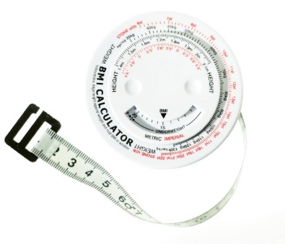
Disqualifying or Limited Medical Conditions
Cardiovascular disease
Heart attack, stroke, angina, vascular disease, high blood pressure, etc.
Diabetes
Respiratory dysfunction
Psychiatric disorders
Hearing and vision problems
Epilepsy/seizures
Drug/substance abuse
For additional information on medical conditions, visit FMCSA’s Driver Medical Fitness for Duty site. Adapted from 49 C.F.R. §391.41 of 649-F
Notes:
Adapted from §391.41 of 649-F
https://www.fmcsa.dot.gov/medical/driver-medical-requirements/driver-medical-fitness-duty

Slide 23
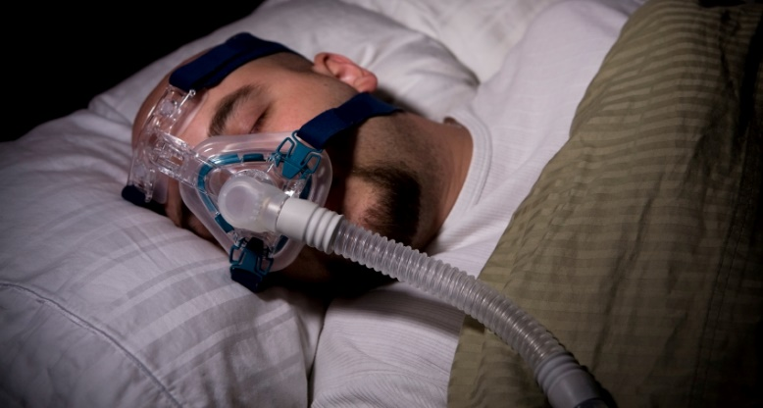
Behavior and Lifestyle Modifications for Better Health

Slide 24
Prioritize Your Health
CMV driving is a challenging job under often difficult conditions.
Drivers have a personal responsibility to wisely manage their own health and lifestyle.
Employer support

Slide 25
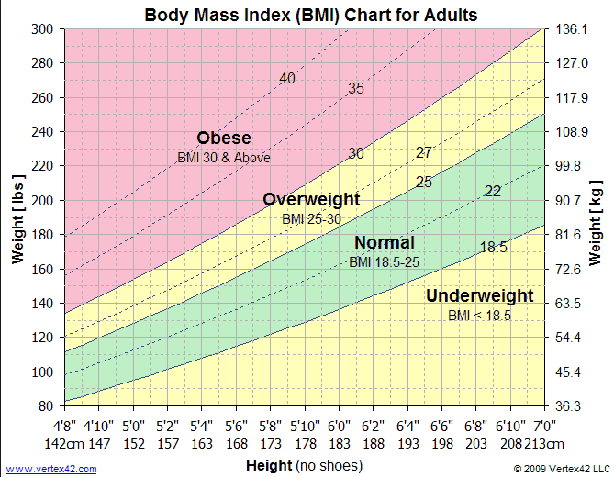
Weight Loss/Maintenance
Strategy: diet and exercise
Small, manageable, realistic goals
Don’t go “cold turkey.”
Acknowledge interim successes.
Make it fun.
Friendly competition
Lifestyle change
Weight loss has “trickle down” effect.

Slide 26
Blood Pressure Reduction
BP-reducing medications
Reduce cardiac stress, reduce blood volume, influence hormones
Weight loss
10 lb loss can normalize BP
Exercise
30 mins/day can lower BP within weeks
Nutrition
Increase whole grains, fruits, veggies, low-fat dairy.
Reduce animal fats, sodium.
Reduce alcohol.
≤ 1 drink/day for women; ≤ 2 drinks/day for men

Slide 27
Cardiovascular Disease – Reduce Your Risk
Quit smoking.
Smoking increases risk for heart attack 2 times.
Improve cholesterol.
Achieve a healthy weight.
Manage blood pressure.
Exercise.
30 mins/day of moderate-intensity exercise (walking) reduces CVD risk.
Manage anger/stress.
Control diabetes.

Slide 28
Exercise
Recommendation:
2.5 hours per week aerobic exercise (e.g., fast walking)
+ Muscle-strengthening workouts twice a week (e.g., weightlifting, pushups).
Consult a physician before beginning an exercise program.
Strategies:
10-minute walks at least twice daily
Use stairs instead of elevator.
Work out more vigorously on weekends/when time permits.
Take exercise equipment with you on trips.
Resistance bands, medicine balls, stability balls, handheld dumbbells
Schedule time to regularly exercise and keep an exercise log.
Set short-term and long-term goals.
Find enjoyable activities and involve friends/family/co-workers.

Slide 29
Nutrition
Strategies:
Start with small, manageable goals, then add to them.
Ex. Reduce soda intake from 3/day to 1/day, then eliminate.
Limit fries to 3 times/week, then replace with side salad.
Strive for 5 servings of fruits or vegetables/day.
Replace “bad” fats (e.g., chips) with “good” fats (e.g., nuts).
Replace simple carbs (e.g., potatoes, sweets) with complex carbs (e.g., whole grains).
Replace sweet drinks with water.
Everything in moderation

Slide 30
Healthy Swaps
Instead of this |  | Eat This
McDonald’s Quarter Pounder |  | McDonald’s Artisan Grilled Chicken Sandwich
Burger King BIG FISHTM Sandwich |  | Burger King Whopper Jr. w/out Mayo
Subway 6” Tuna |  | Subway 6” Club®
Dairy Queen Georgia Mud Fudge Blizzard |  | Dairy Queen Hot Fudge Sundae (Small)
For additional healthy swaps, visit Eat This, Not That!
Notes:
McDonald’s Quarter Pounder:
530 Calories; 27g Fat; 41g Total Carbs; 31g Protein
McDonald’s Artisan Grilled Chicken Sandwich
380 Calories; 7g Fat; 44g Total Carbs; 37g Protein
Burger King Fish Sandwich
510 Calories, 15g Fat; 42g Total Carbs, 22g Protein
Burger King Whopper Jr. w/out Mayo
310 Calories, 18g Fat, 27g Total Carbs, 13g Protein
Subway 6” Tuna
470 Calories, 25g Fat, 41g Total Carbs, 20g Protein
Subway 6” Club
310 Calories, 4.5g Fat, 46g Total Carbs, 23g Protein
Dairy Queen Georgia Mud Fudge Blizzard
660 Calories, 34g Fat, 61g Sugars
Dairy Queen Hot Fudge Sundae (Small)
360 Calories, 19g Fat, 40g Sugars

Slide 31
Diabetes Management
Involve your physician.
Glucose monitoring
Medications
Exercise.
Improves blood-sugar control and insulin response
Nutrition
Quit smoking.
Brush and floss teeth regularly.
Prevent dental decay
OSA evaluation
Diabetes increases risk for OSA and OSA worsens insulin resistance
Watch your feet!
Nerve damage in extremities

Slide 32
OSA
Seek screening/testing.
Symptoms
Loud, disruptive snoring
Waking with gasping or choking
Non-refreshing sleep
Excessive sleepiness/fatigue
Morning headaches or dry throat
Poor memory, clouded thoughts, irritability
Preventable and manageable
Maintain a healthy weight.
Avoid alcohol and sedatives before sleeping.
Quit smoking and/or tobacco.
Avoid sleeping on back.
Keep nasal airflow open.
Treatments
Weight loss
Positive airway pressure (PAP)
Delivers pressurized air to prevent collapse and snoring
Positive effects experienced immediately

Slide 33
Steps to Behavior Change
Health, Wellness, Alertness, Performance
Unaware of problem
Aware, thinking of change
Planning to change
Taking action
Sustaining action

Slide 34
Steps to Behavior Change: An Example
Unaware of problem: Joe seeks a job with Company Z and undergoes the DOT medical exam.
Aware, thinking of change: Joe learns that he is obese and has Stage 2 hypertension (HTN).
Planning to change: Joe is given a temporary card and must return in 3 months to prove his HTN is under control. Joe makes an appointment with his PCP to discuss his HTN and treatment options.

Slide 35
Steps to Change: An Example
Taking action: Joe is prescribed a beta blocker and follows his PCP’s recommendation to reduce his sodium intake and increase his exercise.
Sustaining action: At his 3-month recertification, Joe has lost 20 lbs and his HTN is under control. Joe continues making small, manageable behavior changes to improve his health.

Slide 36
Work-Site Wellness Programs

Slide 37
Work-Site Wellness Programs
Work-site wellness programs are needed in the CMV industry.
Ideal for CMV drivers
Time spent on the job
Trucking community support
Benefits driver and carrier
Leading carriers are implementing these programs for employees.
Return on investment

Slide 38
Does Your Company Have a Work-Site Wellness Program?
How does it work?
What works well with your existing programs?
What could be improved upon?
Success stories?

Slide 39
Health and Wellness Case Study
A collaboration with Schneider National, Inc. (SNI), Atlas Ergonomics, and United HealthCare
Recommendations for a work-site wellness program:
Strong marketing program to gain participation
Educational component
Accessible occupational health clinics
Privacy of health information crucial
Clinical and physical testing

Slide 40
Health and Wellness Case Study
Recommendations for a work-site wellness program:
Trust and rapport between program staff and drivers
Exercise coaching and monitoring
Regular communication, individualized, follow-up
Provide at no-cost
Participation incentives
Reduced premiums, health benefits, etc.

Slide 41
Takeaways
Poor health is prevalent among CMV drivers.
Influences job safety
Overweight/obesity is the common denominator.
Health efforts should focus on weight control and prevention.
Initiating and maintaining a healthy lifestyle over the road is achievable!
Hard work + patience = SUCCESS!
Work-site wellness programs are ideal for CMV drivers.
Motivate and incentivize drivers to make healthy behavior changes.
Provide strategies and support.

Slide 42
Additional Resources
http://www.drivinghealthy.org/
http://www.nafmp.com/en/downloads.html

Slide 43
Questions?

